Slide 1
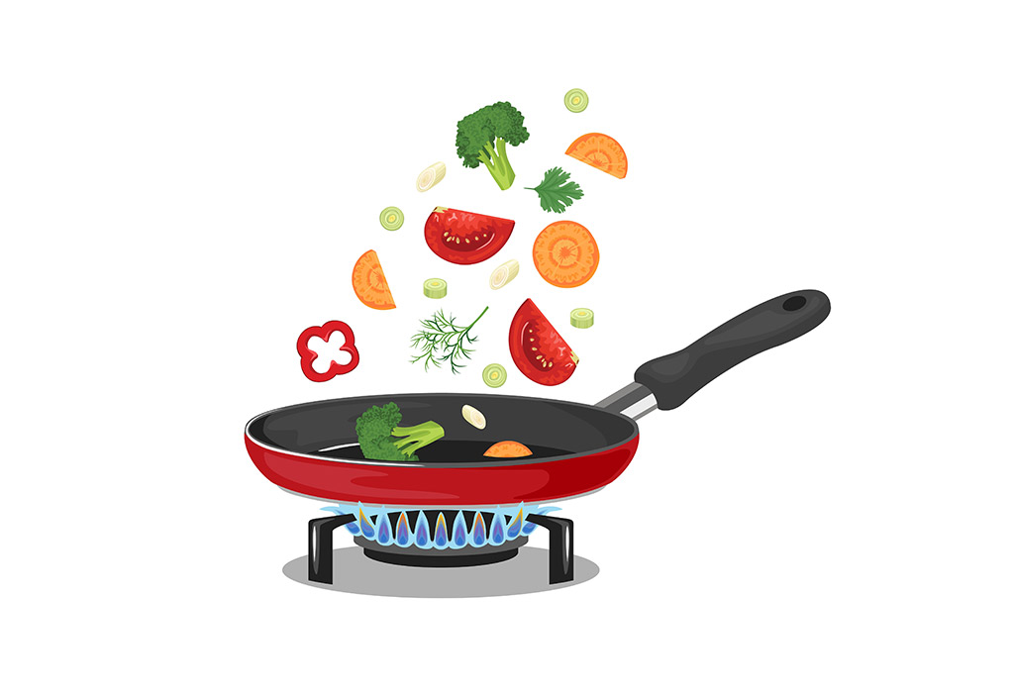
"Cookbook, but not a cookbook..."
By Edita

Slide 2
Contents
Concept
Progress
Challenges
Demo
Todo

Slide 3
Vegia

Slide 4
Vegan Cooking Challenge App
Challenges from Yoda
Gems save memories
Difficulty increases over time
Educational aspect and active involvement outside app
Notes:
Teaches to cook, about processed stuff, how to combine meals and they can be similar to what people already know like burger or cheese: i.e., make vegan burger from beans, make vegan cheese from cashews and nutri-yeast etc Tree could grow with each completed challenge; Root could grow leaves; Yoda could give space rocks or sth.

Slide 5
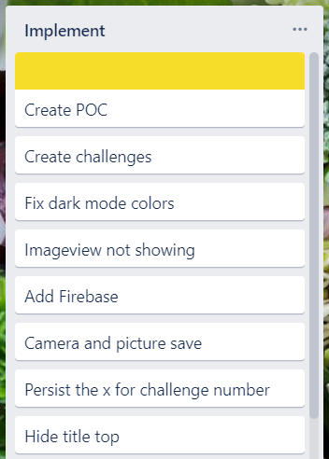
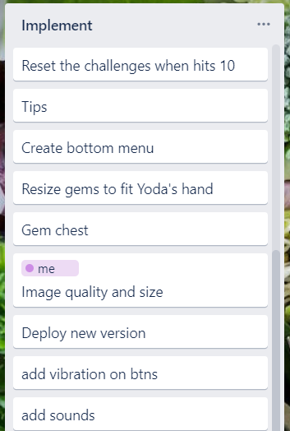

Proof Of Concept

Slide 6
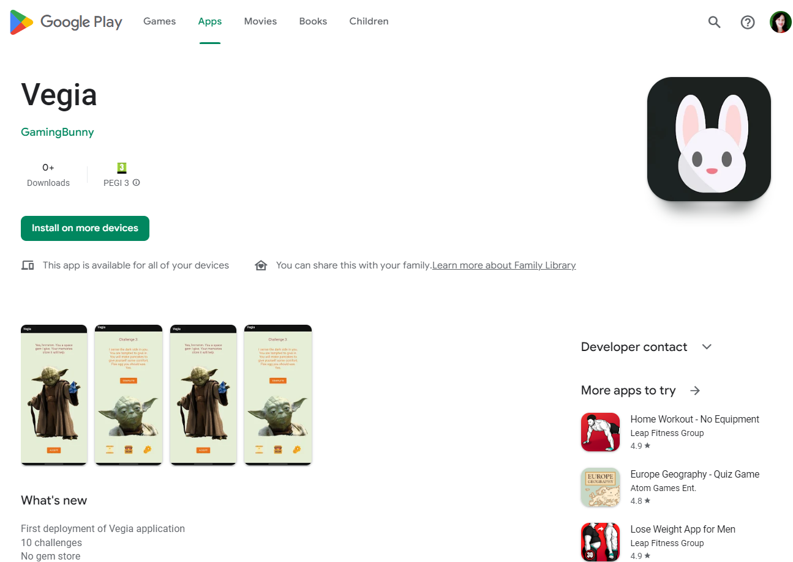

Deployment

Slide 7
Demo Time

Slide 8
To do:
Improve image quality by storing locally
Add sounds and vibrations
Deploy final version

Slide 9
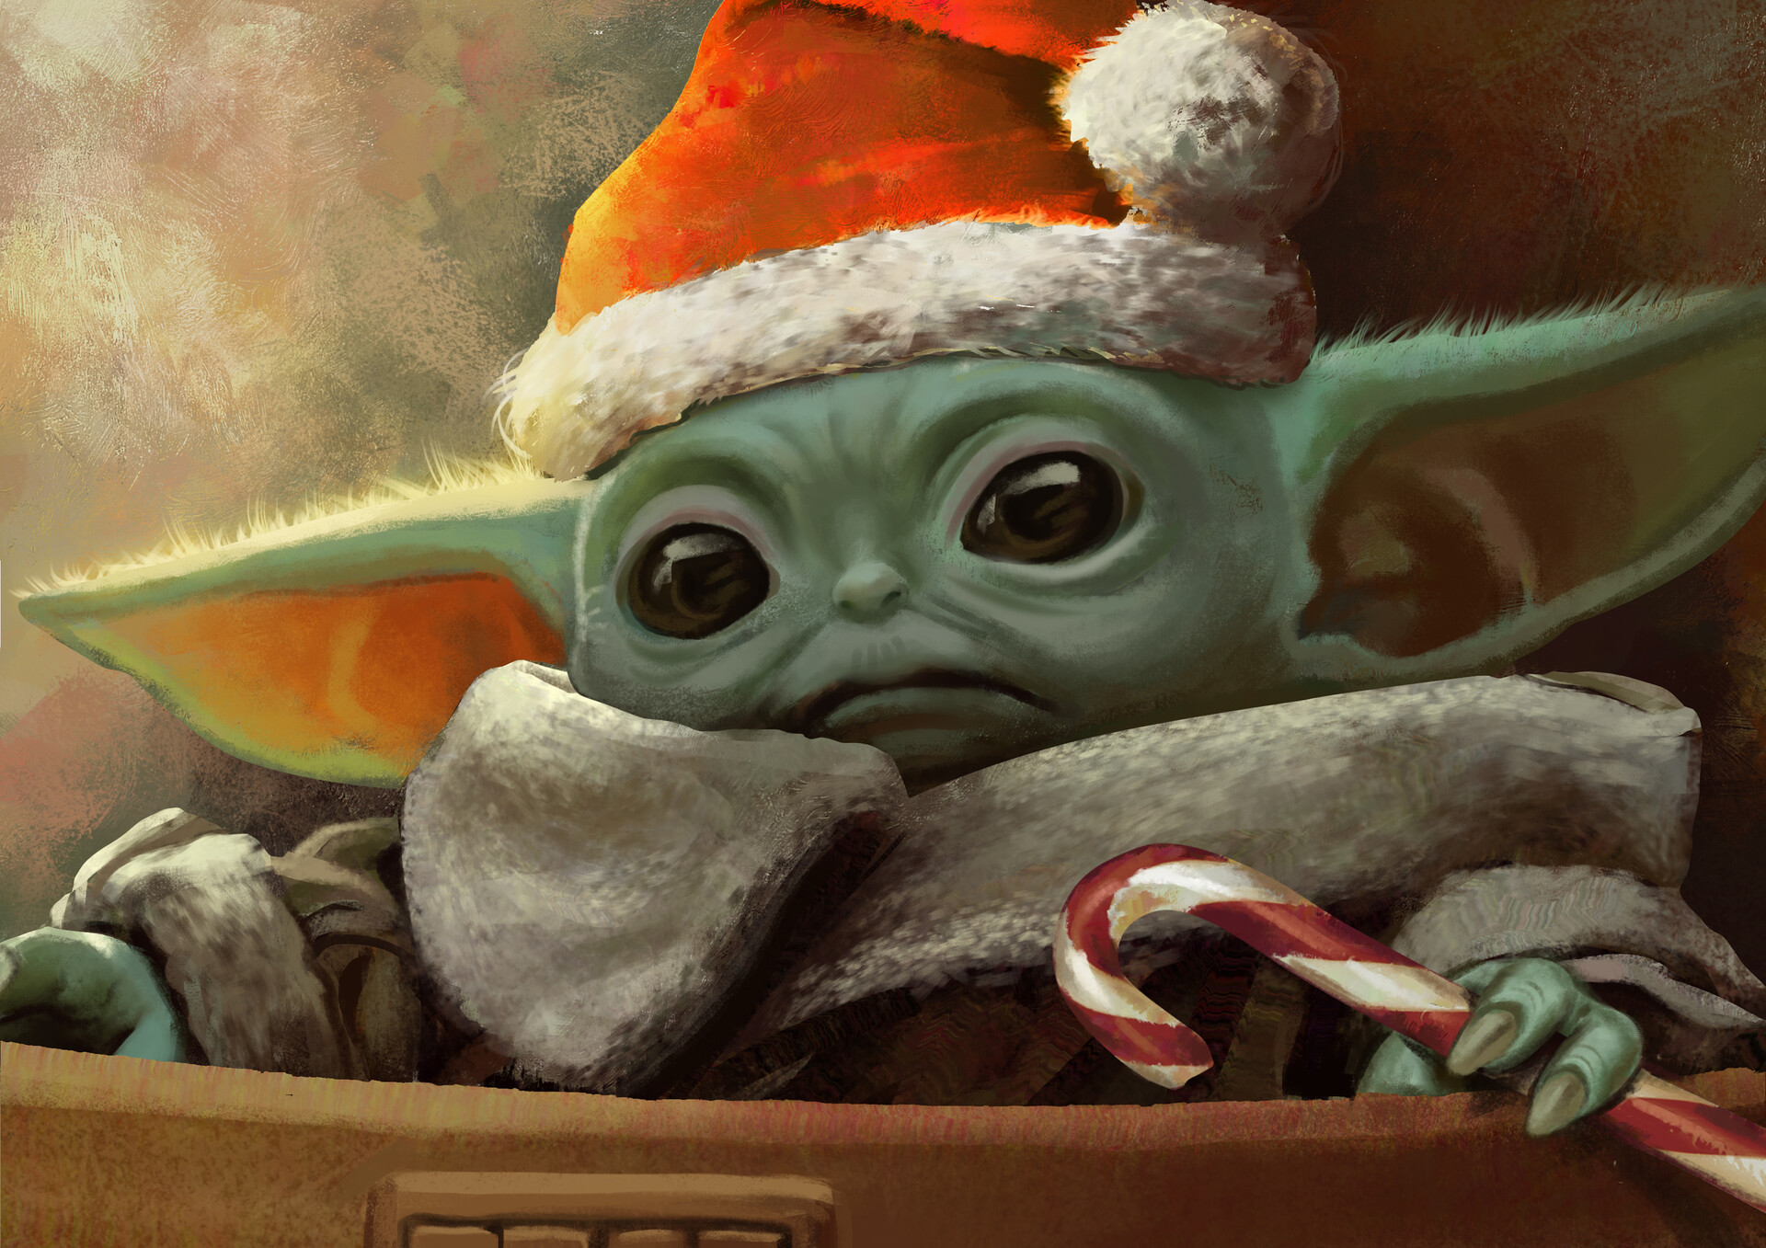
Very good you have been, on the nice list you are !

Slide 10
YAY! Holidays!

